Slide 1
挑战
React Native

Slide 2
Flex-box
更高效的布局

Slide 3
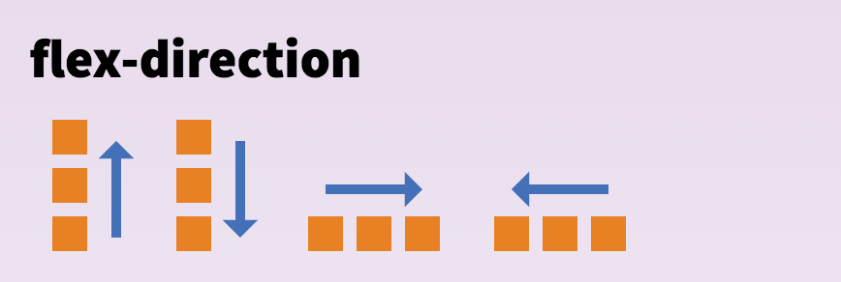
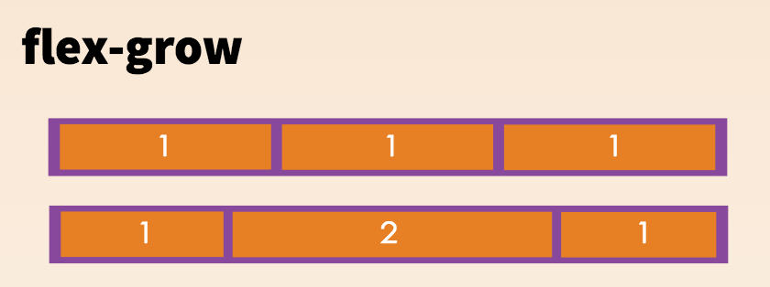
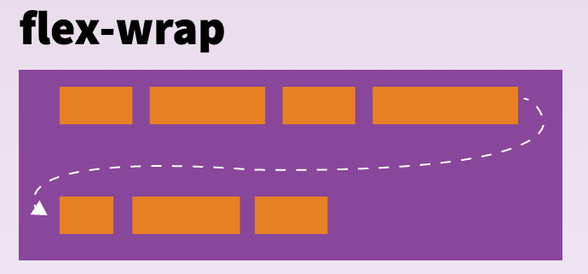
父节点
子节点
无

Slide 4
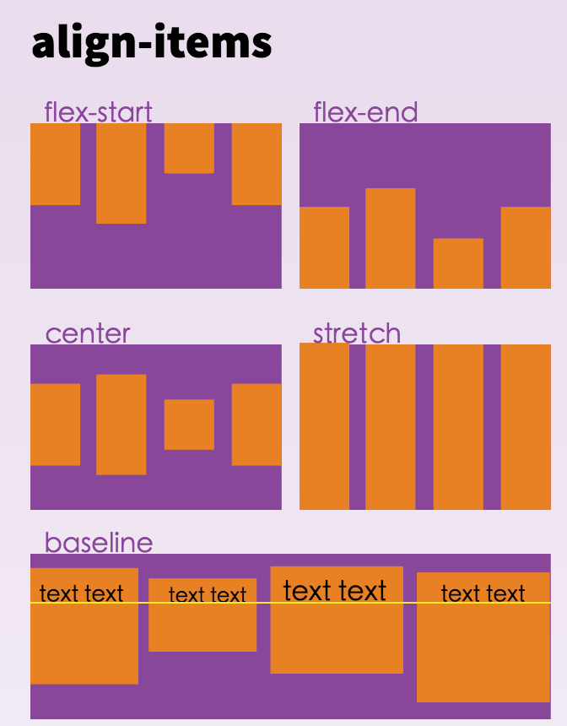
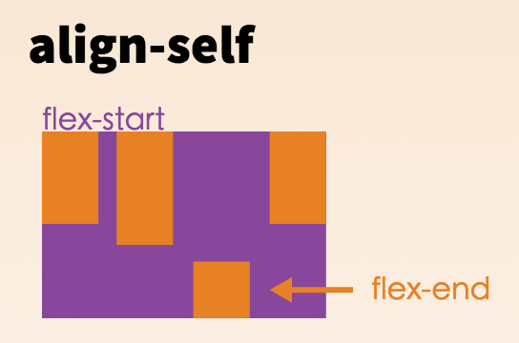
父节点
子节点

Slide 5
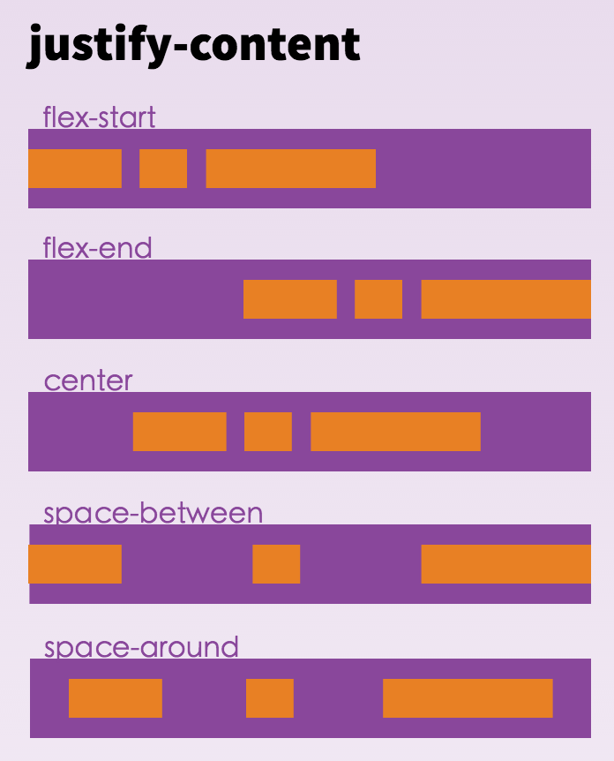
父节点
子节点

Slide 6
alignItems enum('flex-start', 'flex-end', 'center', 'stretch')
alignSelf enum('auto', 'flex-start', 'flex-end', 'center', 'stretch')
flexDirection enum('row', 'column')
justifyContent enum('flex-start', 'flex-end', 'center', 'space-between', 'space-around')
flex number

